Slide 1

User-Centered Website Development: A Human-Computer Interaction Approach

Slide 2
Daniel D. McCracken
City College of New York
Rosalee J. Wolfe
DePaul University
With a foreword by:
Jared M. Spool, Founding Principal,
User Interface Engineering
PowerPoint slides by Dan McCracken, with thanks to Rosalee Wolfe, S. Jane Fritz of St. Joseph’s College, and Rhonda Schauer

Slide 3

10. Typography
In this chapter you will learn about:
The basic terminology and concepts of working with type
A dozen typefaces and their characteristics
What screen-friendly fonts are, and three examples
How typography on the Web differs from typography in print
How—using guidelines provided—to design typography for the Web that is readable, effective, and attractive

Slide 4

Basic Concepts
Font
  Set of all the printable or displayable text characters in a specific style and size
    12-point Times New Roman bold
Typeface is the design of for a set of fonts
  Times New Roman
Typeface family consists of all the sizes and variations of a typeface
Serif
  A decorative line, circle, or other flourish at the end of a stroke in a letter

Slide 5
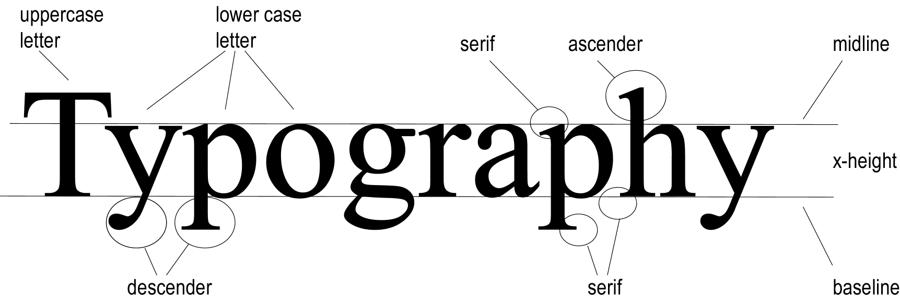
10.2 Concepts and Terminology

Slide 6

A sans serif font, Arial

Slide 7
Font Size
A point is 1/72nd of an inch
  Mainly used to measure vertical distances
A pica is 1/6 of an inch
  Mainly used to measure horizontal sizes
An em is a relative measure and is equal to the point size of the font

Slide 8
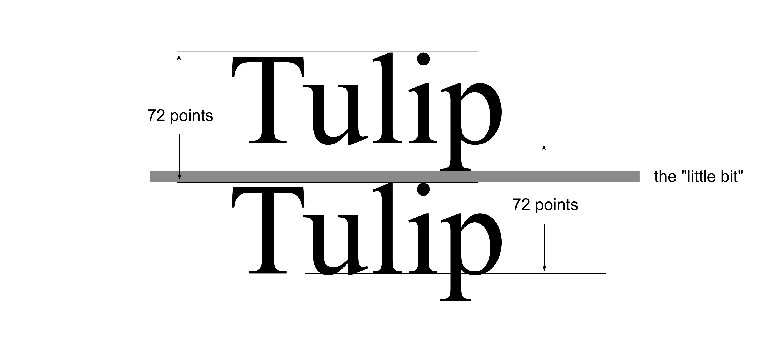
What does the size of a font mean?

Slide 9

These letters are all 72 points; the lines are one inch (= 72 points) apart
How big type is depends on the font size and on the design of the font family. Don’t forget the “little bit”!
The fonts are Garamond, Goudy, Bookman Old Style, AlleyCat ICG, Caslon Open Face, Arial Black, Park Avenue, and Ultra Condensed Sans Two

Slide 10
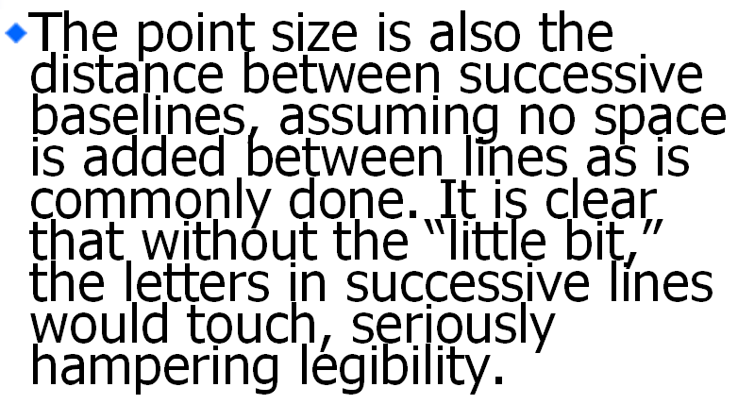
Some text with reduced line spacing, to show what happens without the “little bit”

Slide 11
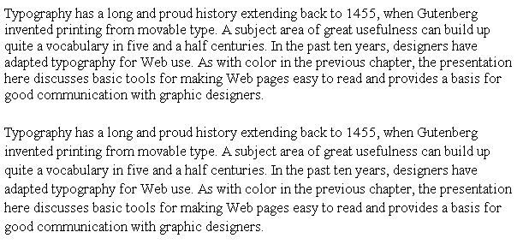
Times New Roman, 10 point, with 1pt leading and with 3pt leading

Slide 12
10.3 A Dozen Font Families
2 serif
6 sans serif
2 monospaced
1 script
1 Webdings
1 Symbol (Greek)

Slide 13


Times New Roman and its screen-friendly cousin Georgia—in same font size

Slide 14

Times Roman letters have oblique stress; Georgia has vertical stress

Slide 15

The pixel view: how Georgia gets vertical stress (and the letters are bigger)

Slide 16
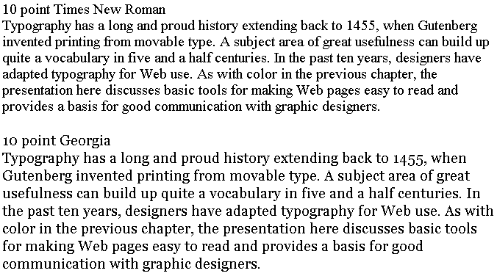
Times New Roman and Georgia

Slide 17
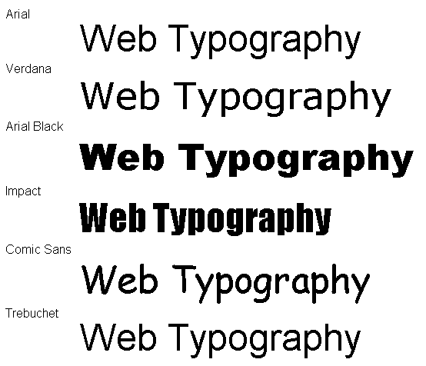
Six sans serif fonts

Slide 18




Comparison of some sans serif fonts
Arial bold and Arial Black
Arial and Impact
Arial and Comic Sans
Arial and Trebuchet

Slide 19
Arial and its screen-friendly cousin Verdana—in same font size
Web Typography
Web Typography

Slide 20
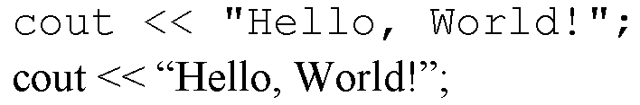
Courier New and Times New Roman
Courier New is a monospaced font: the comma gets as much horizontal space as the W. For program listings, this is exactly what we want. Seldom desirable otherwise.

Slide 21
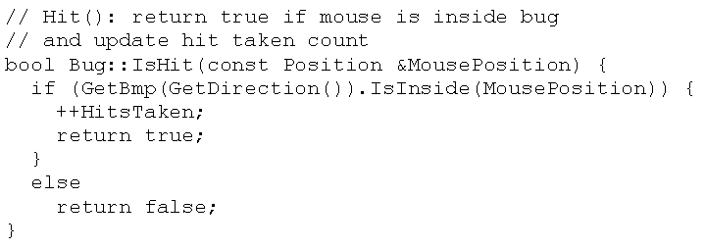
A bit of C++ code in Courier

Slide 22
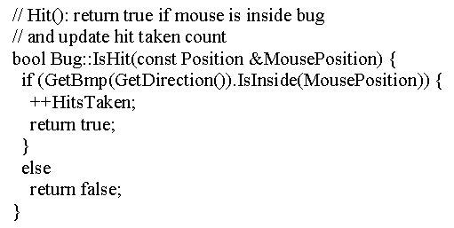
In Times New Roman the same thing seems strange—to a programmer

Slide 23
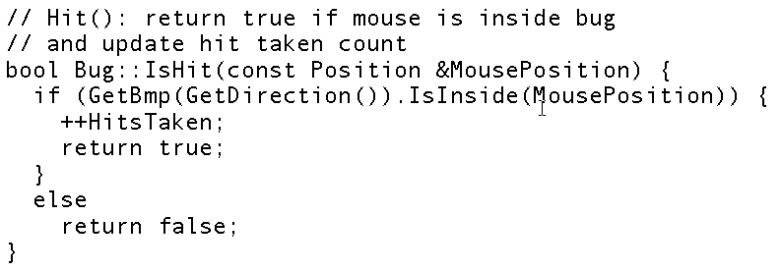
Andale Mono is a screen-friendly version of Courier

Slide 24
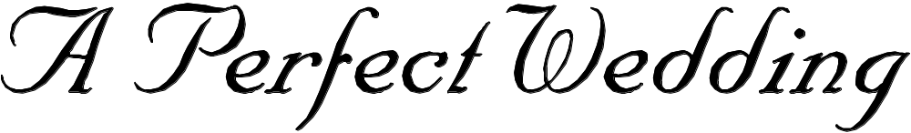
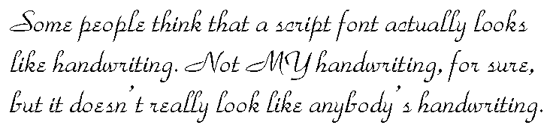
Nuptial Script

Slide 25
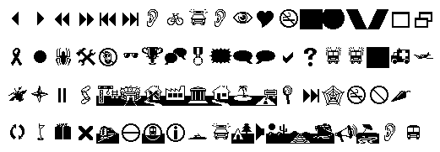

Webdings

Slide 26

The Greek alphabet in the Symbol font

Slide 27
10.4 A Web Page is Not a Printed Page
Some things a Web designer can’t be sure of:
The resolution of the user’s monitor
The size of the user’s browser window
The text size: users can change it
The settings and quality of the user’s monitor, in terms of brightness, contrast, and color balance
The fonts available to a user
Very different from print design!

Slide 28



10.5 Text in graphics
What if you want to use a font your users probably don’t have? Answer: make a graphic of it
With a drop shadow

Slide 29
10.6 Guidelines: Body Type on the Web
Use Georgia or Verdana
Use 10 point or 12 point type
Avoid bold or italic in body type, except for a few words for emphasis
Use upper case only for the first word of sentences, proper names, etc.
Use left alignment
Use dark text on a light background
Never use underlining for emphasis

Slide 30
10.7 Guidelines: Display type on the Web
Big is beautiful
Use any typeface that is legible—if your users have it; insert as a graphic if they don’t
Use the HTML line-height attribute for control of line spacing
Use HTML letter spacing and word spacing to get effects you want
Don’t use any form of animation of text—ever

Slide 31
Summary
In this chapter you learned:
The basic terminology and concepts of typography
A dozen typefaces and their characteristics
What a screen-friendly font is, and how it works
How typography on the Web differs from typography in print
Guidelines for text and display type on the Web

